Slide 1
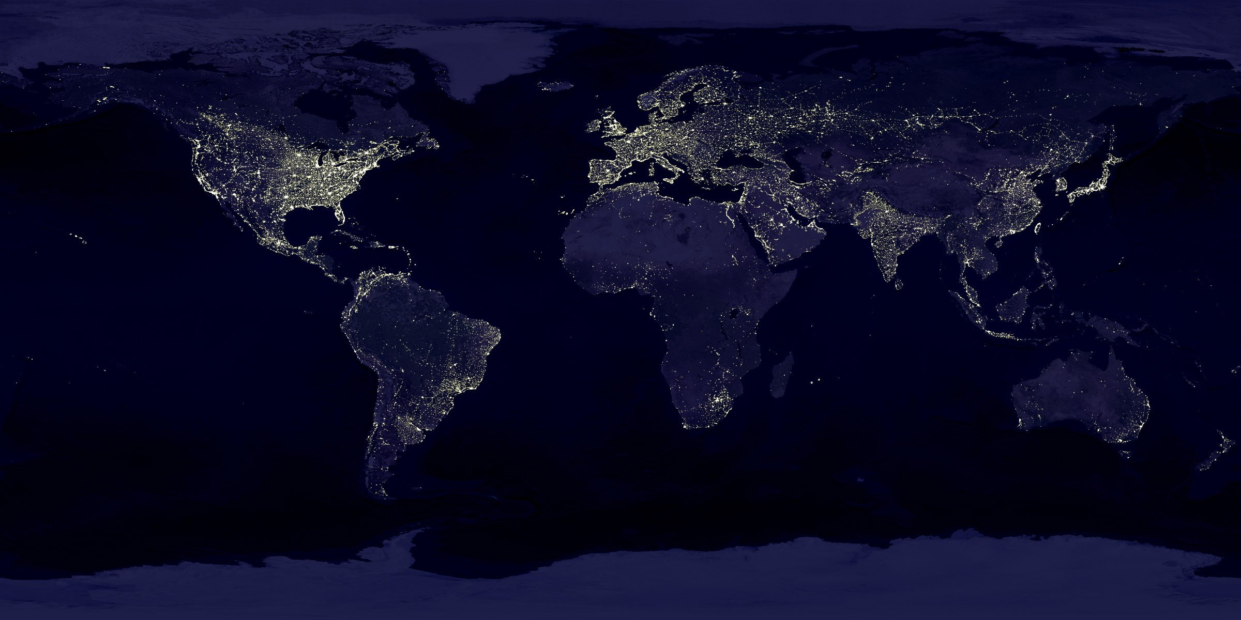
Global Life Expectancy Analysis
Group 5
Arda Cankat Bati
Qingyuan Jin
Weinan Li
Wei Zhang

Slide 2

OUTLINE
Introduction
Dataset Overview
Motivation
Differences between countries
Relevancy Analysis
Change from 2000 to 2015
Conclusion
Conclusion

Slide 3

Introduction

Slide 4

Introduction
Life Expectancy: The average period that a person may expect to live.
Problem: affected by too many variables
Harder to analyse for individuals, more
predictable for groups
Selecting variables that apply in general is
the key

Slide 5

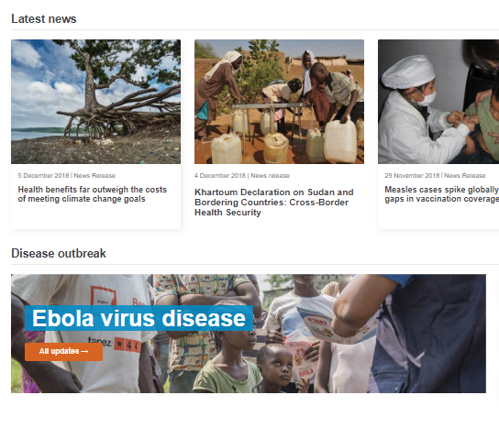
Dataset
Dataset taken from kaggle.com
Generated from the World Health Organization website
193 countries, 21 Features, between 2000 – 2015
Features: Economical, Physical, Diseases etc.
Some incomplete points, required more cleaning than normal

Slide 6

Motivation

Slide 7
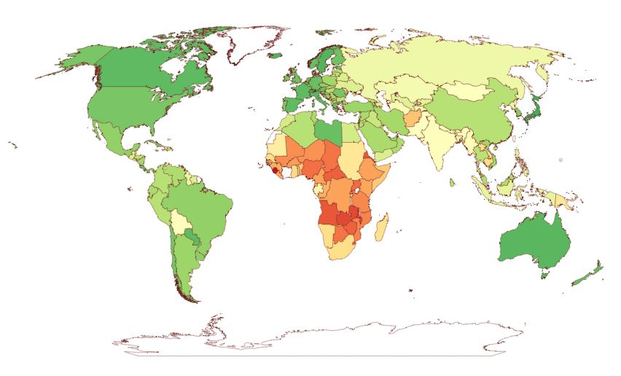
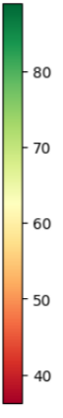
Life Expectancy in the year 2000
age

Slide 8
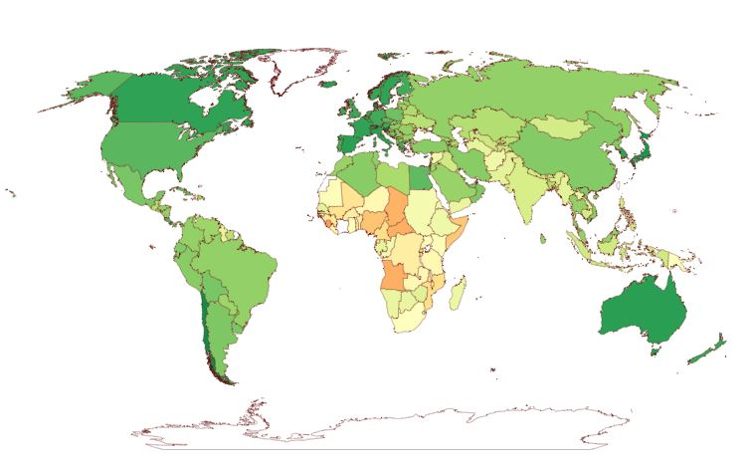
Life Expectancy in the year 2015
age

Slide 9
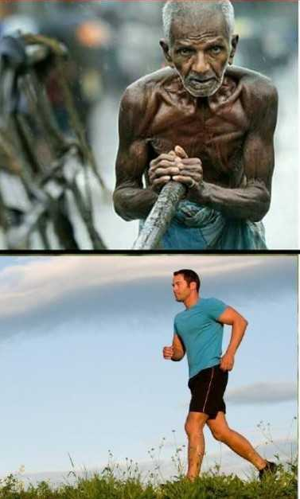
Motivation
Big difference between the countries
What features play a major role in this difference?
Overall increasing life expectancy from 2000 to 2015
How can we keep it up?
How can the lower life exp. countries do better?

Slide 10

Difference

Slide 11
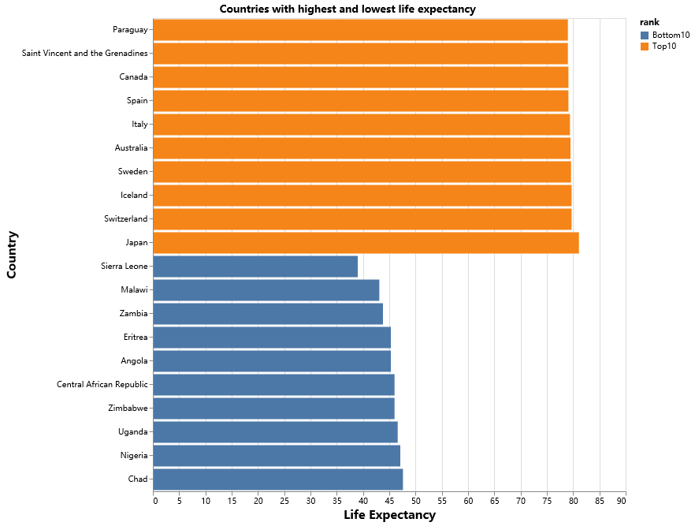
The huge gap in our world
Countries with highest and lowest life expectancy
The Top and Bottom 10
People in the Top 10 countries averagely live 40 years longer than the bottom 10
In 2000, Japan had a life expectancy twice larger than that of Sierra Leone

Slide 12
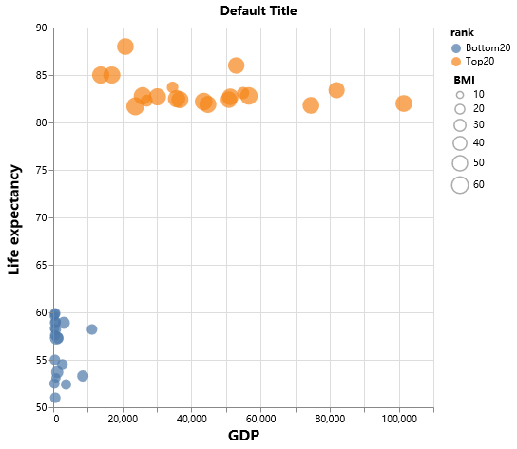
What creates this gap?
GDP vs Life Expectancy
Top and Bottom 20
GDP per capita has a clear effect on the difference between them
Interesting observation: BMI of 24 is considered healthy, bottom 20 countries are closer to this number
This may be related to lack of enough nutrition in low GDP countries

Slide 13
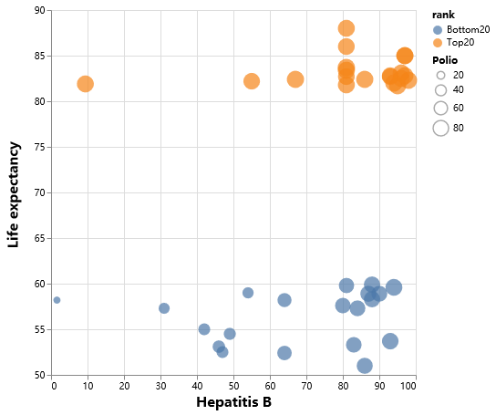
What creates this gap?
Hepatitis B vs Life Expectancy
Despite similar coverage of important vaccines, poor countries are still suffering
Relevance is harder to assess in this situation
We need a better method to decide on the relevance of each feature

Slide 14

Relevancy
Analysis

Slide 15


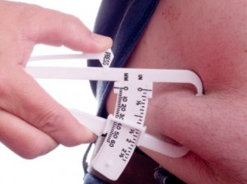
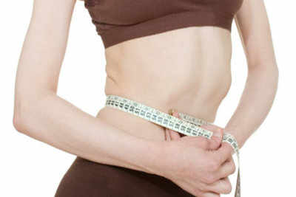
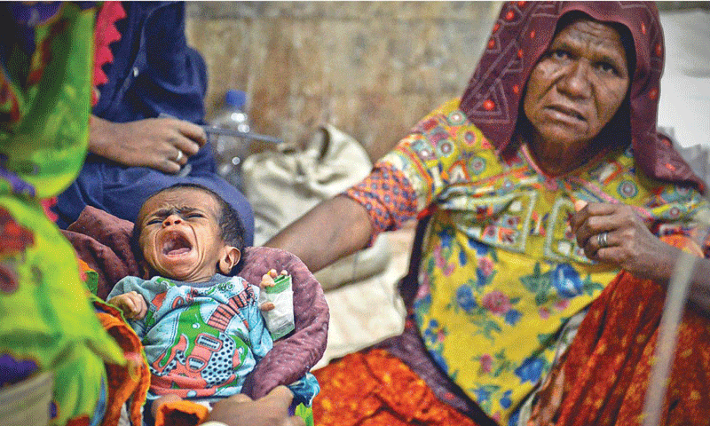

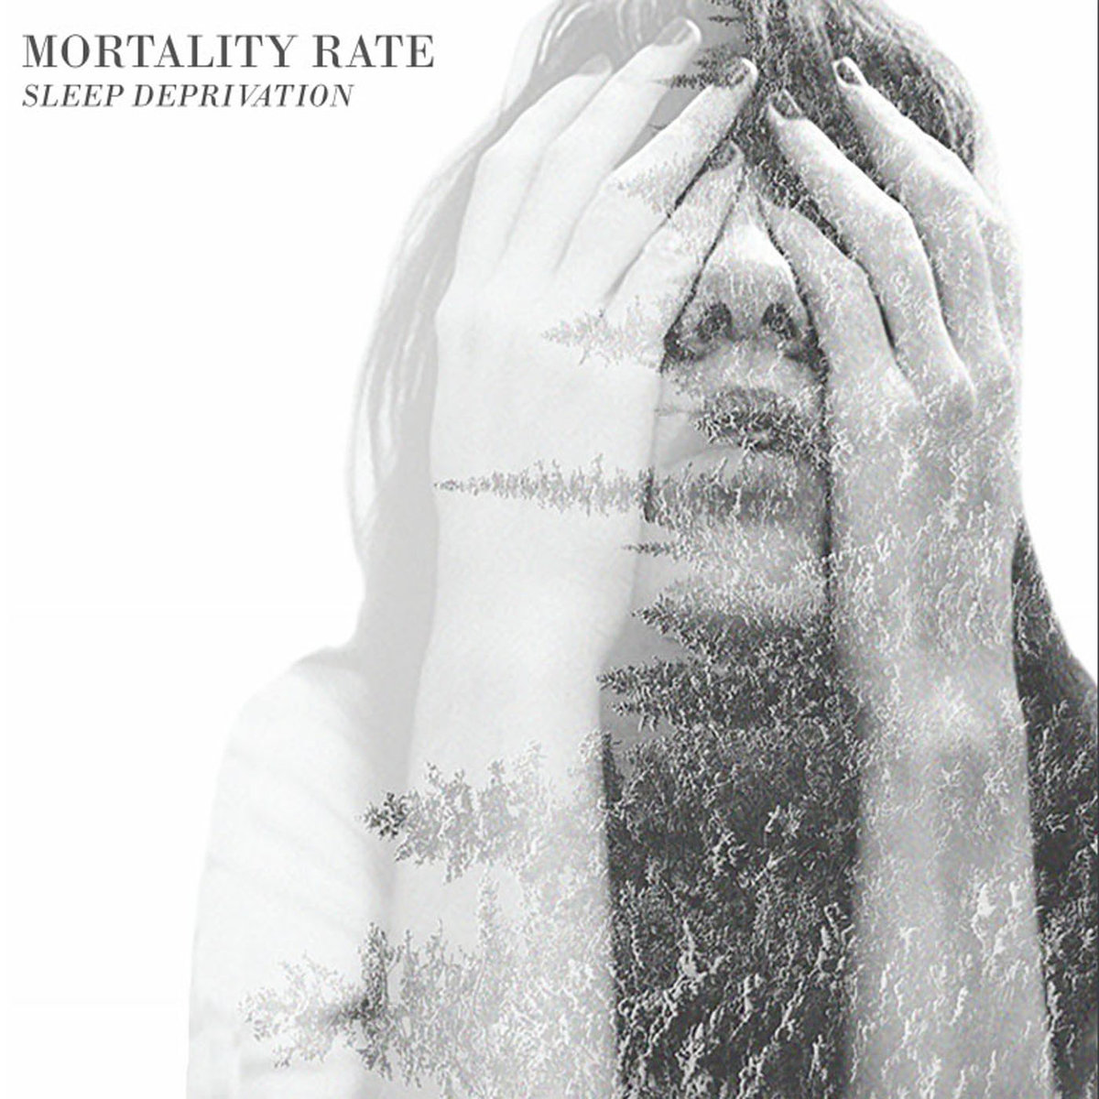



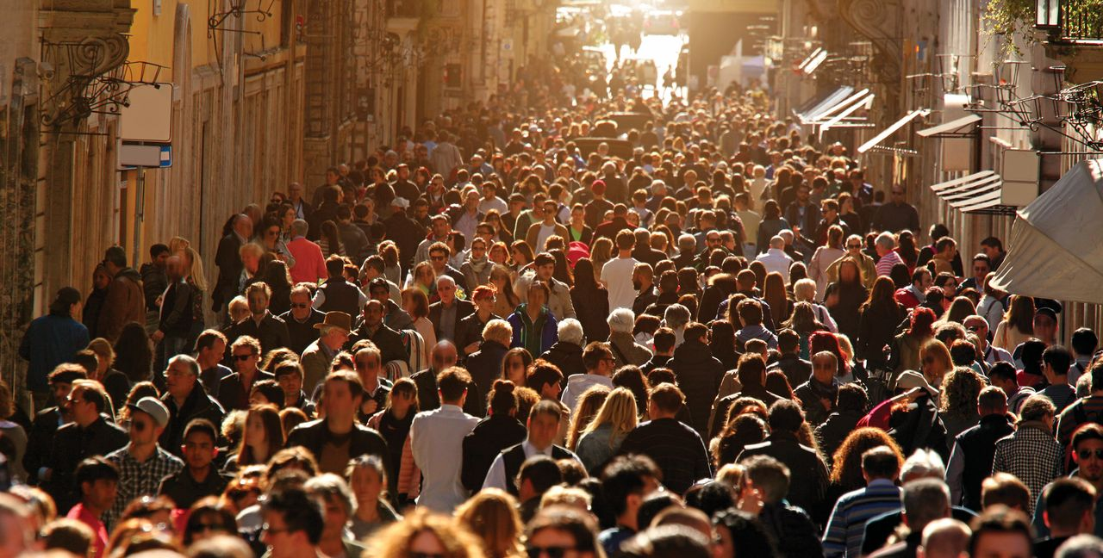


19 Features
 

Slide 16
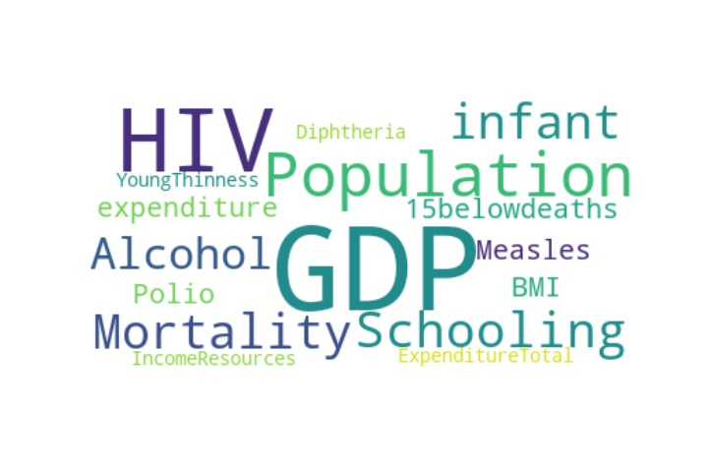
Principal Component Analysis
6 most relevant Features:
GDP
HIV
Hepatitis B
Adult Mortality
Income comp. index
Schooling (may be tied to GDP)
Goal
Select the most relevant features
Make more accurate statements

Slide 17
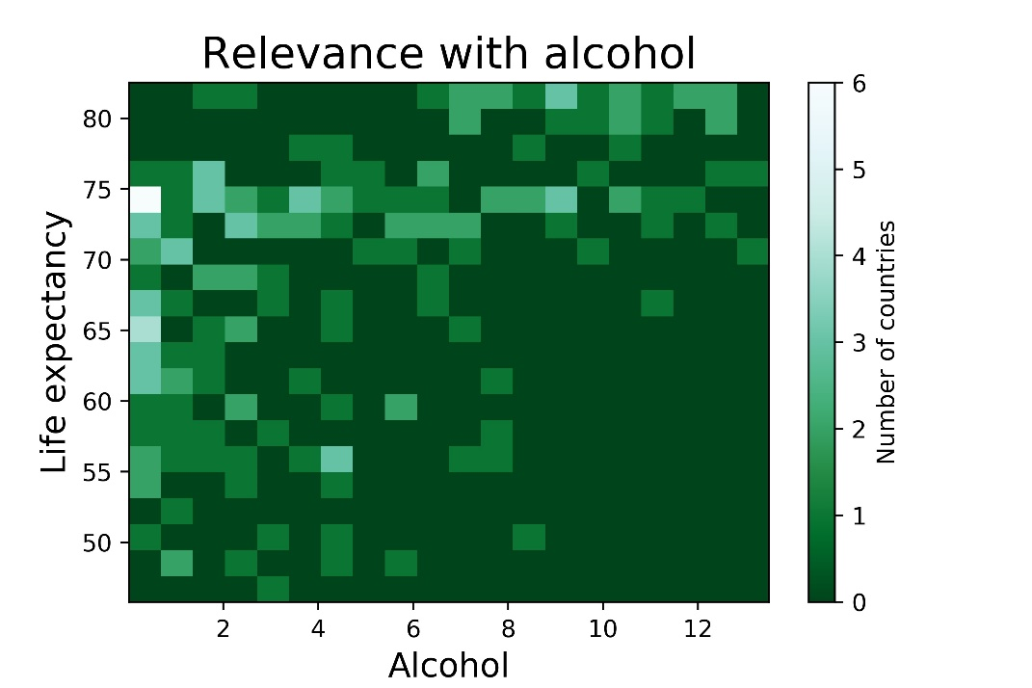
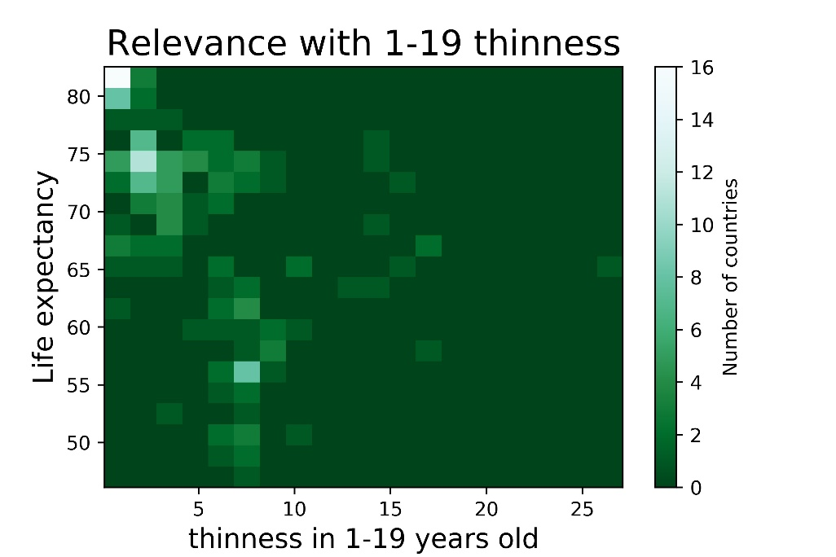
PCA
Lower Correlation

Slide 18
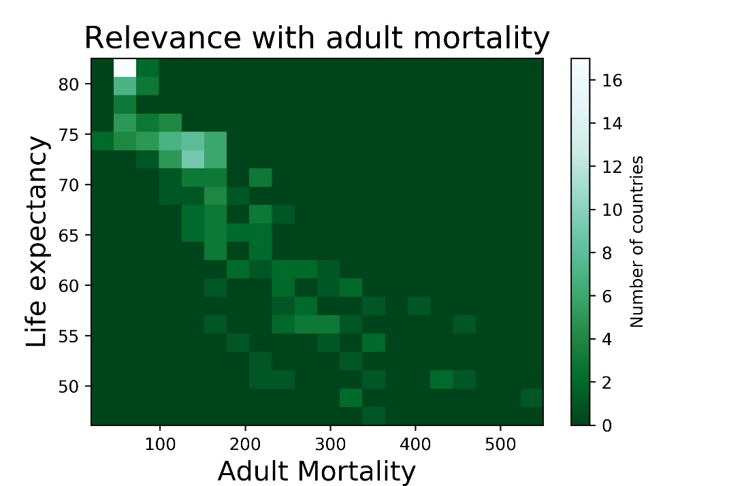
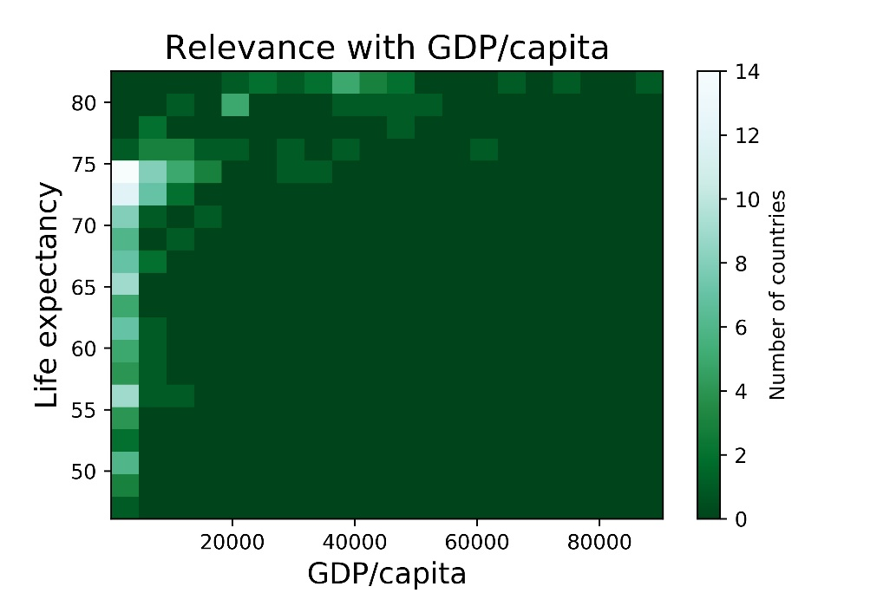
PCA
Higher Correlation

Slide 19
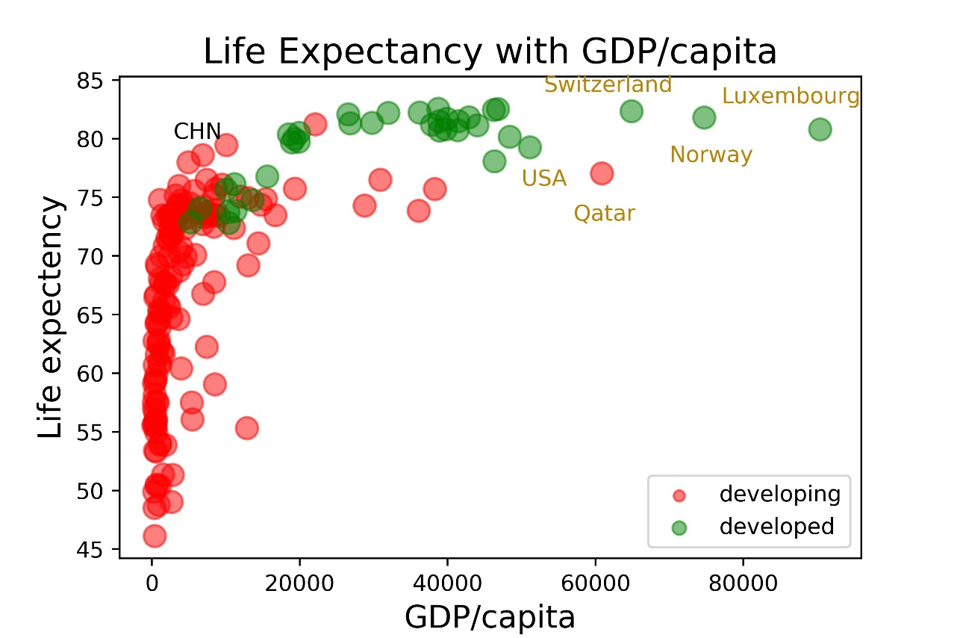
Life Expectancy with GDP
Life expectancy clearly positively relevant with GDP per capita and development status
A negative, decaying exponential distribution. Fast increase in the beginning, very stable for the later stages.
Northern Europe and USA
Developing countries

Slide 20

Change
from 2000 to 2015

Slide 21
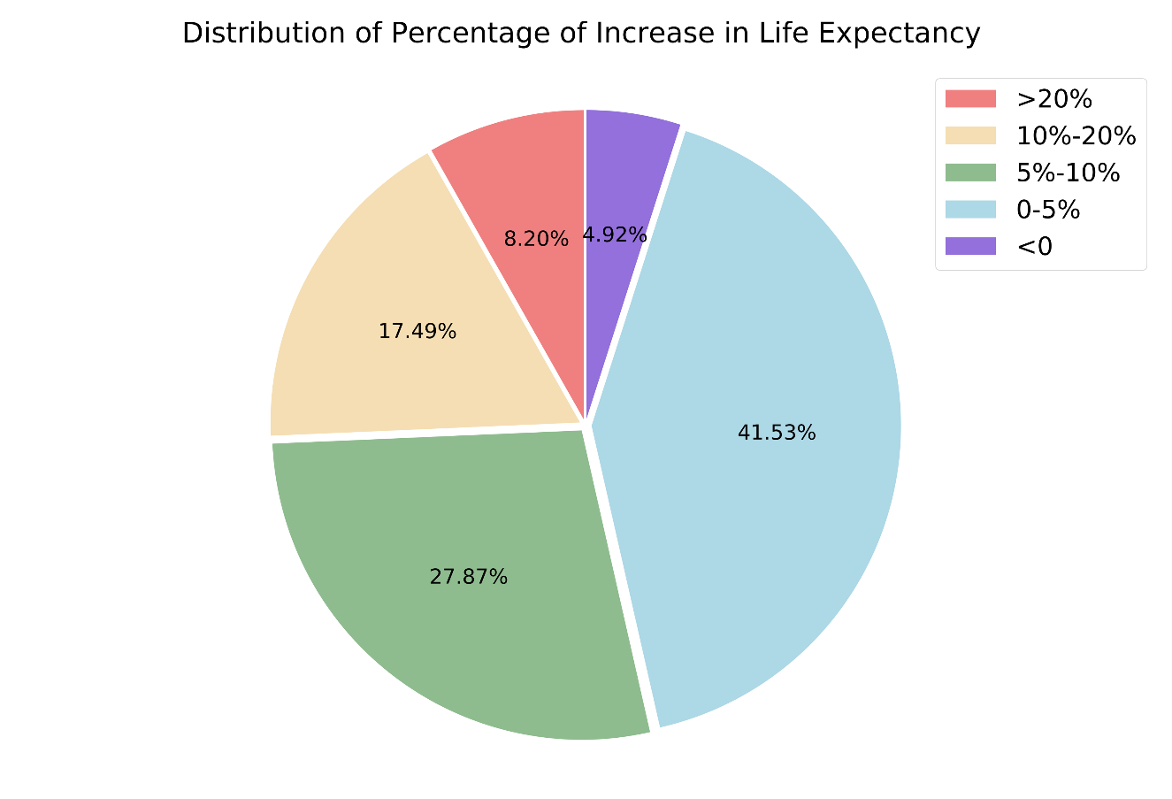
All countries
All countries’ life expectancy percentage of increase
Here we see the distribution in 5 parts
We will go into detail about top 10 increasing countries

Slide 22
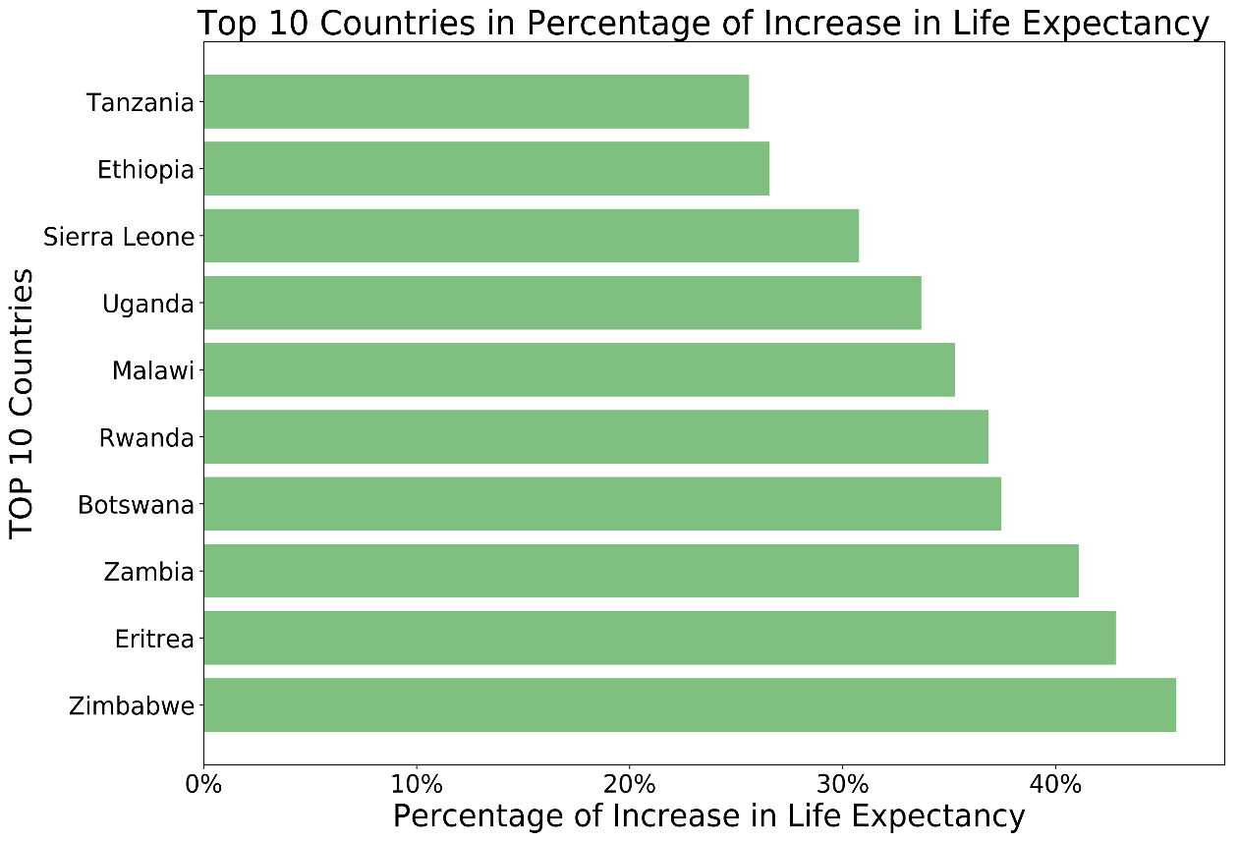
Top 10 countries
Mostly located in Africa
Have higher than 25% percent change in life expectancy
Zimbabwe had more than 45% increase
Great change is possible

Slide 23
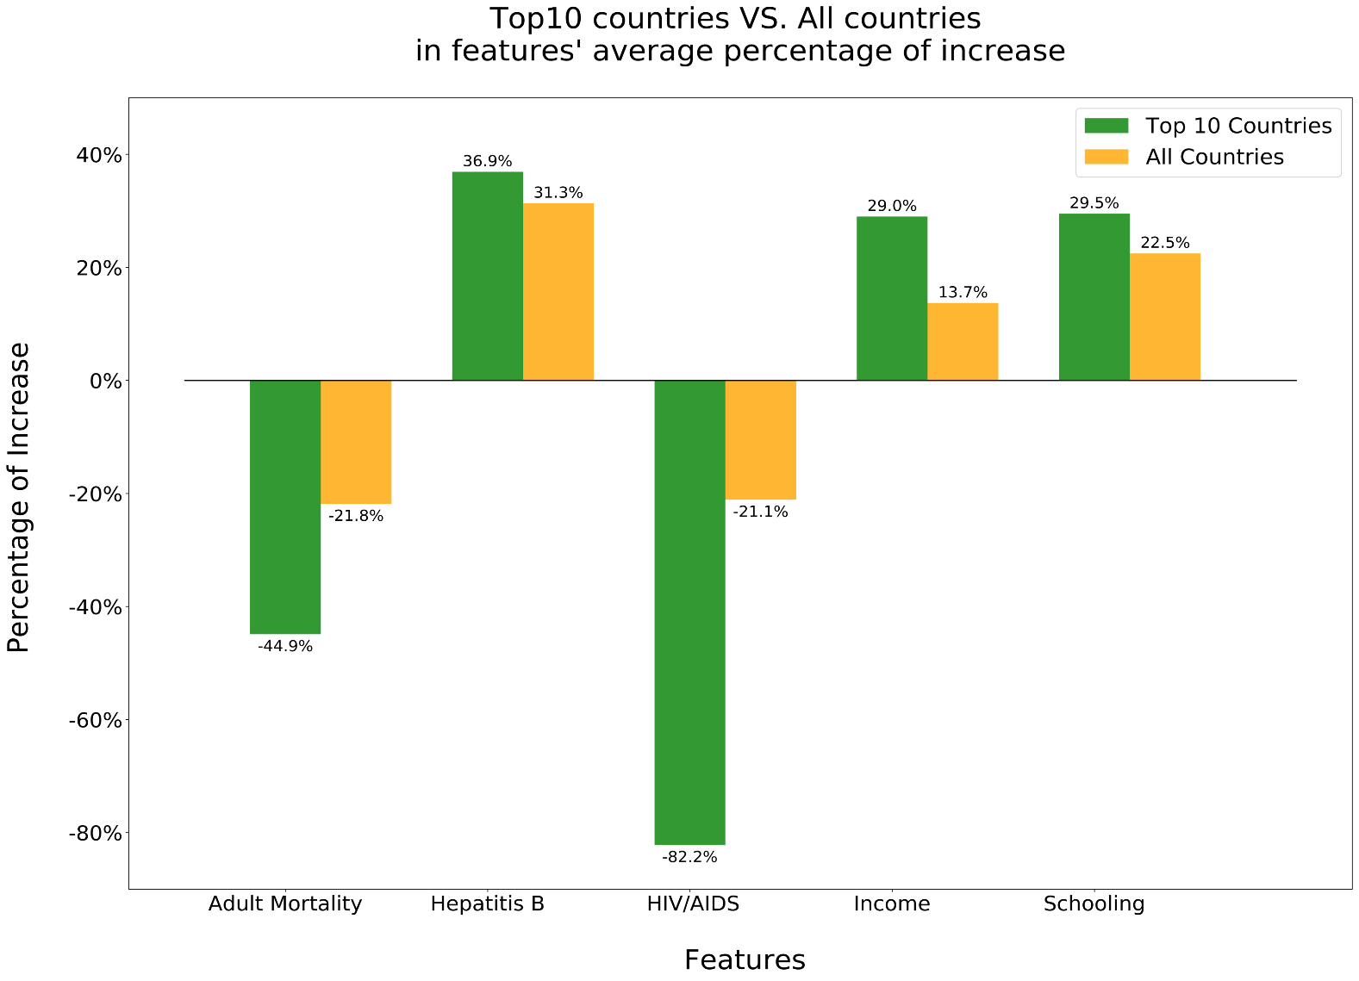
Ratio: 2.11
Ratio: 2.05
Ratio: 3.89

Slide 24
Conclusion

Slide 25
Conclusion
In general, features that affected life exp. most were GPD, Adult Mortality, HIV, Hepatitis B Vaccine
Countries that want to rapidly increase their life expectancy should focus on: HIV, income compositions index and adult mortality
More research about underlying relations between the features, especially for GDP per capita vs others

Slide 26
THANK YOU

